Slide 1
Process Modeling
Systems analysis and design, 6th edition
Dennis, wixom, and roth

Slide 2
Learning Objectives
Explain the rules and style guidelines for data flow diagrams.
Describe the process used to create data flow diagrams.
Create data flow diagrams.

Slide 3
Key Definitions
Process model
A formal way of representing how a business process operates
Illustrate activities that are performed and how data moves between them
Logical process models describe processes without suggesting how they are conducted.
Physical process models include process implementation information
Data flow diagramming
A popular technique for creating process models

Slide 4
Data Flow Diagrams
What do dfds tell us?

Slide 5
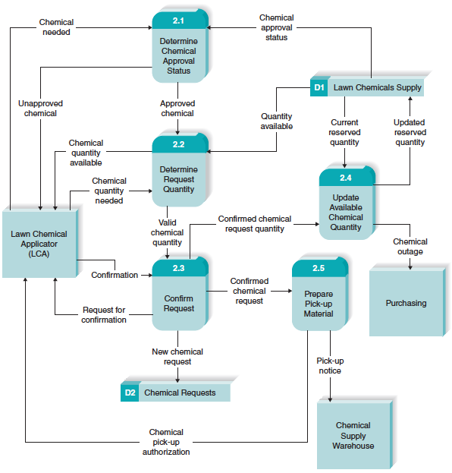
Reading a Data Flow Diagram

Slide 6
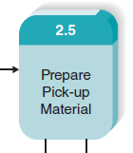
DFD Elements
Process
An activity or function performed for a specific business reason
Can be manual or computerized
Includes the following:
A number
A name (verb phrase)
A description
At least one output data flow
At least one input data flow

Slide 7
DFD Elements, con’t.
Process, con’t.
Logical process models omit any processes that simply move or route data and leave the data unchanged.
You do include logical processes that:
Perform computations (e.g., calculate grade point average)
Make decisions (e.g., determine availability of ordered products)
Sort, filter or otherwise summarize data (e.g., identify overdue invoices)
Organize data into useful information (e.g., generate a report or answer a question)
Trigger other processes (e.g., turn on the furnace or instruct a robot)
Use stored data (create, read, update or delete a record)

Slide 8
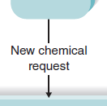
DFD Elements, con’t.
Data flow
A single piece of data or a logical collection of data
Data Flow names describe the content of the data flow but not how it is implemented
Always starts or ends at a process
Includes the following:
A name (noun)
Description
One or more connections to a process

Slide 9
DFD Elements, con’t.
Data flow, con’t.
A data flow is data in motion.
an input of data to a process, or the output of data (or information) from a process.
the creation, deletion, or update of data in a file or database (called a data store on the DFD).
A data flow is depicted as a solid-line with arrow.
Control flows (non-data flows) trigger processes, such as ‘time to run the weekly payroll’
The control flow is depicted as a dashed-line with arrow.

Slide 10
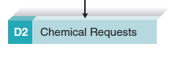
DFD Elements, con’t.
Data Store
Most information systems capture data for later use.
A data store is a collection of data that is stored in some way
Include the following:
A number
A name (noun)
Description
One or more input data flows (somewhere in process model)
One or more output data flows (somewhere in process model)

Slide 11
DFD Elements, con’t.
Data Store, con’t.
If data flows are data in motion, think of data stores as data at rest.
Data stores should describe “things” about which the business wants to store data.
Data flows leaving the data store are data retrievals
Data flows entering the data store are updates or new data added

Slide 12
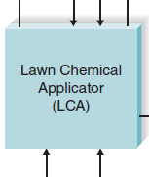
DFD Elements, con’t.
External entity
A person, organization, or system that is external to the system
Has interactions with the system (adds data to system or recieves data from system)
Include the following:
A name (noun)
Description

Slide 13
Depicting Business Processes with DFDs
Business processes are too complex to be shown on a single DFD
A deliberate hierarchy is created with multiple “levels” of DFDs
To build the hierarchy, use Decomposition
Child diagrams show a portion of the parent diagram in greater detail

Slide 14
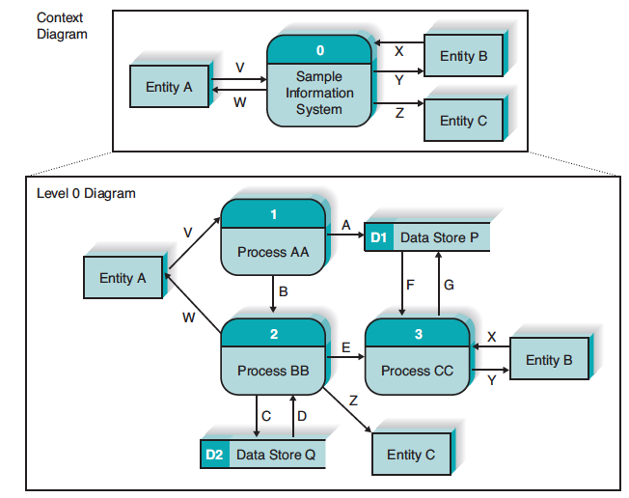
DFD Hierarchy
Context Diagram decomposes into Level 0 diagram

Slide 15
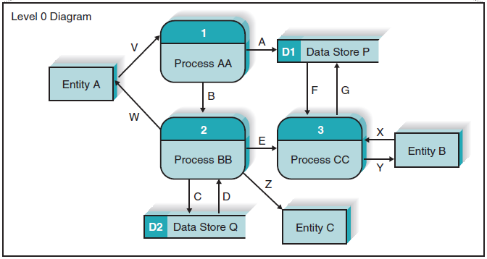
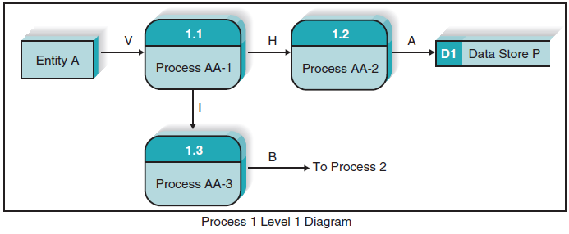
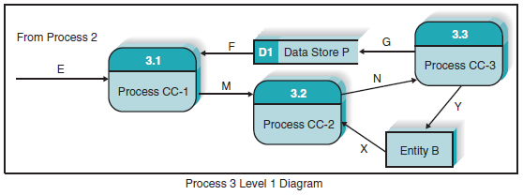
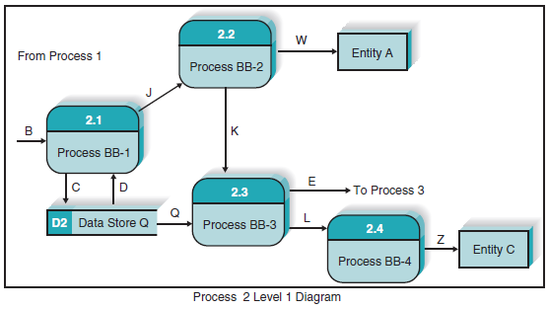
DFD Hierarchy
Processes on Level 0 diagram each decompose into separate Level 1 diagrams
Processes on Level 1 diagrams may or may not be decomposed into separate Level 2 diagrams.
Processes are decomposed until each process is a single-purpose, primitive process.

Slide 16
Balancing
Ensures that information presented at one level of a DFD is accurately represented in the next level DFD.
Data flows on parent diagram are carried down to child diagram.
Child diagram adds new processes and new data flows

Slide 17
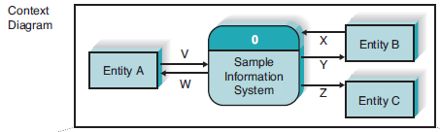
Context Diagram
Top-level DFD in every process model
Shows the context into which the business process fits
Shows the overall business process as just one process (process ‘zero’)
Shows all the external entities that receive information from or contribute information to the system

Slide 18
Level O Diagram
Shows all the major processes that comprise the overall system – the internal components of process 0
Shows how the major processes are interrelated by data flows
Shows external entities and the major processes with which they interact
Adds stored data via the data stores

Slide 19
Level 1 Diagrams
Create one level 1 diagram for every major process on the level 0 diagram
Shows the internal processes that comprise a single process on the level 0 diagram
Shows how information moves to and from each of these processes
If a parent process is decomposed into, say, three child processes, the these three child processes entirely and completely make up the parent process

Slide 20
Level 2 Diagrams
Shows all processes that comprise a single process on the level 1 diagram
Shows how information moves to and from each of these processes
Level 2 diagrams may not be needed for all level 1 processes
Correctly numbering each process helps the user understand where the process fits into the overall system

Slide 21
Diagram Numbering
Correctly numbering each process helps the user understand where the process fits into the overall hierarchy
Context Diagram is always “Process 0”
Level 0 processes are always numbered with integer value (1, 2, 3, etc.)
Level 1 processes always have one “dot”: parent number “dot” unique number (1.1, 1.2, 1.3, etc.)
Level 2 processes always have two “dots”: parent number “dot” unique number (1.1.1, 1.1.2, 1.1.3, etc.)

Slide 22
Alternative Data Flows
Where a process can produce different data flows given different conditions
We show both data flows and use the process description to explain why they are alternatives
Tip -- alternative data flows often accompany processes with IF statements

Slide 23
Process Descriptions
Text-based process descriptions provide more information about the process than the DFD alone
CASE tools enable easy creation of descriptions
If the logic underlying the process is quite complex, more detail may be needed in the form of
Structured English
Decision trees
Decision tables

Slide 24
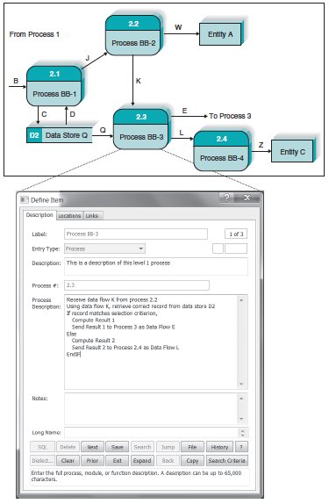
CASE Entry of Process Description

Slide 25
Your Turn
At this point in the process it is easy to lose track of the “big picture”.
Describe the contribution of data flows, data stores, and processes to a process model.
Describe in your own words the relationship between the DFDs and the ultimate new application being developed.

Slide 26
Creating Data Flow Diagrams
How dfds are developed

Slide 27
Steps in Building DFDs
Build the context diagram
Identify the external entities and the major inflows they supply and the outflows they receive
Identify all major processes encompassed by the Context Diagram
Each major event / use case is “handled” by a process
Create DFD “fragments” for each event / use case
Each DFD fragment is a mini-diagram showing the process and the external entities and data stores with which it interacts.

Slide 28
Steps in Building DFDs, con’t.
Organize DFD fragments into level 0 diagram
Decompose each level 0 process into a level 1 diagram; decompose level 1 processes into level 2 diagrams as needed; etc.
Validate DFDs with user to ensure completeness and correctness

Slide 29
Integrating Use Cases
DFDs start with events, use cases and the requirements definition
The DFDs often flow directly from the use cases
Names of use cases become major processes on the Level 0 diagram
Steps in the use case become processes on the Level 1 diagram
Inputs and outputs become data flows on the Level 1 diagram (and below)

Slide 30
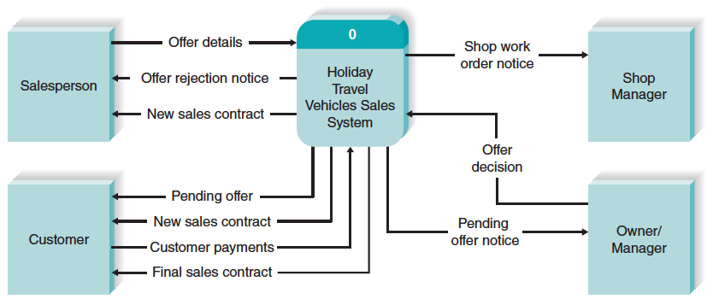
Illustration – Developing DFDs
Creating the Context Diagram

Slide 31
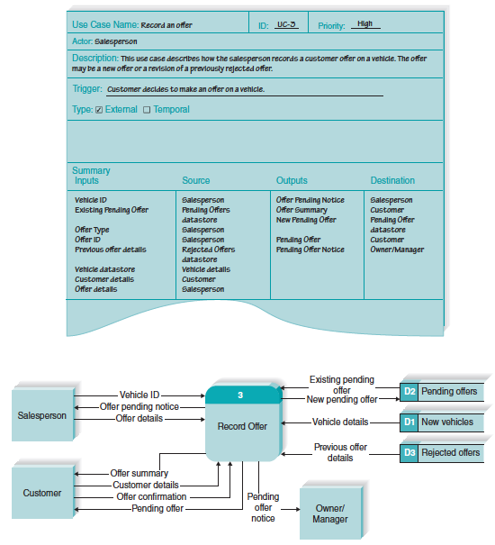
Illustration – Developing DFDs
Create a DFD “fragment” based on a use case

Slide 32
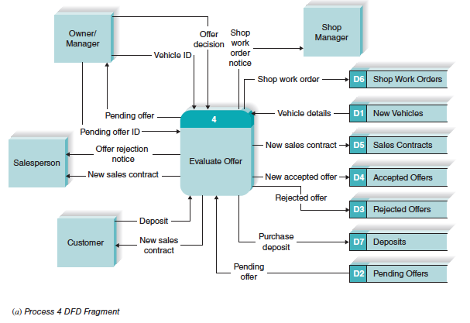
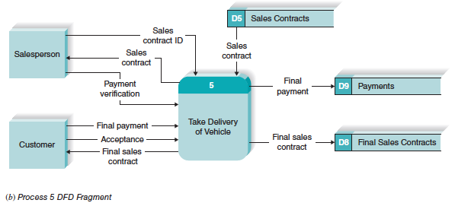
Illustration – Developing DFDs
Merge DFD “fragment” diagrams into the Level 0 diagram

Slide 33
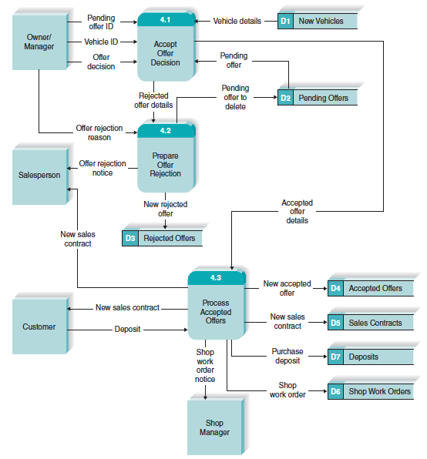
Illustration – Developing DFDs
Develop Level 1 diagrams for every process on the Level 0 diagram

Slide 34
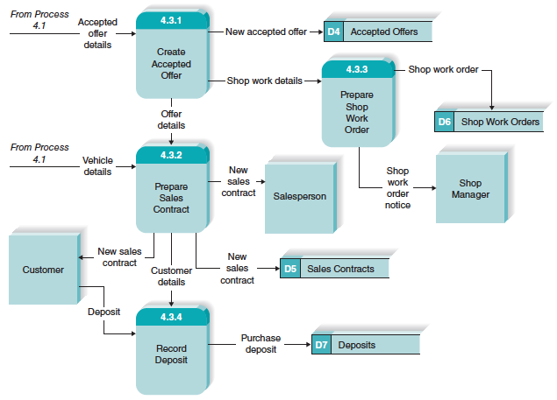
Illustration – Developing DFDs
Develop Level 2 diagrams for any process on a Level 1 diagram that appears busy or complex

Slide 35
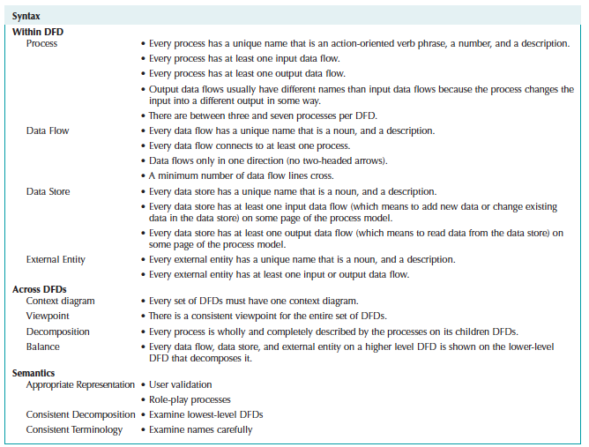
Evaluate DFDs for Quality

Slide 36
Common DFD Errors
Syntax errors – violating “drawing” rules
Every data flow must connect to a process.
Every process must have at least one inflow and one outflow.
Semantics errors – errors in the meaning of the diagrams
Walk-through diagrams with users
Verify that inputs shown are logically sufficient to produce the outputs
Check for consistent levels of decomposition
Check for consistent use of terminology

Slide 37
Online Car Rental System

Slide 38
System Requirements
Processes

Slide 39
Online Car Rental System Context Diagram
Context Diagram

Slide 40
External Entities
External Entities

Slide 41
Input to the System

Slide 42
Input

Slide 43
Outputs to customers

Slide 44
Rental Summary

Slide 45
Reservation

Slide 46
Payment Process

Slide 47
If Credit Card is Declined

Slide 48
Diagram 0
It details process 0 (the System)
It is the child of the context diagram

Slide 49
Data Flow Diagram 0

Slide 50
Rental Summary

Slide 51
Process Payment

Slide 52
Book Car

Slide 53
Diagram 0
It details process 0 (the system)
it is the child of the context diagram
The input and output flows of a parent DFD, must be maintained in the child DFD
Red arrows are coming from context diagram

